Slide 1
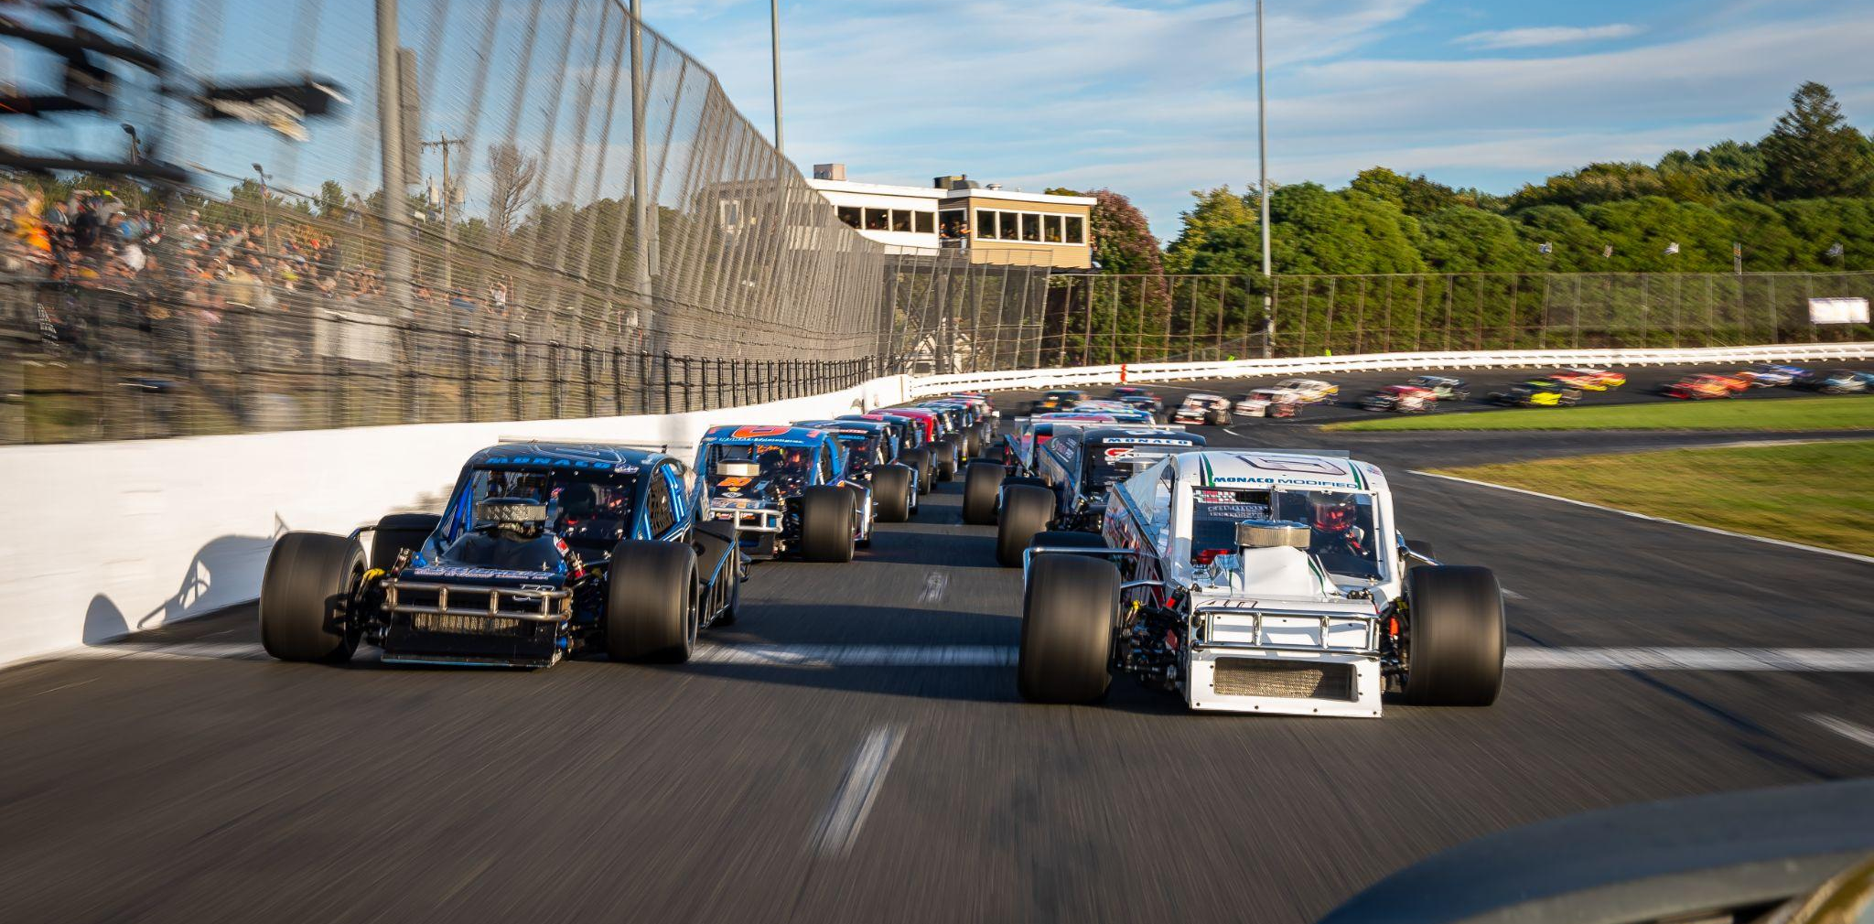
2023 Driver Marketing Presentation

Slide 2
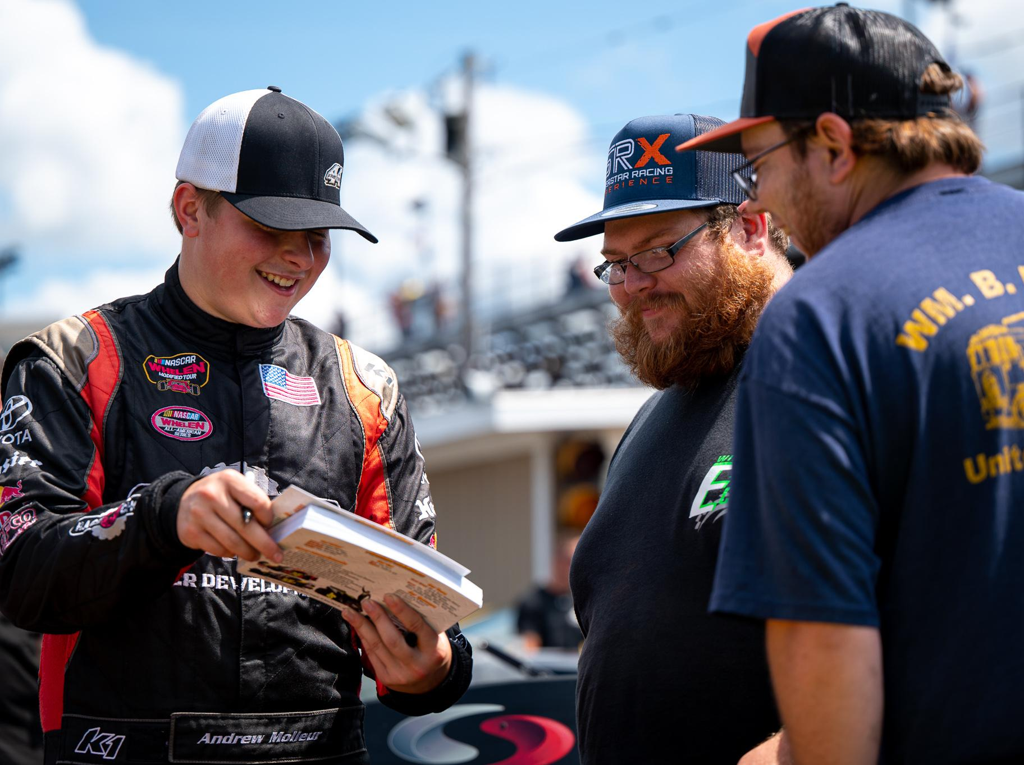
Short Track Racing at Stafford Speedway
5 reasons to get involved in Short Track Racing
Hyper-local brand awareness
Localized, passionate audience
Unique driver personalities
Regional celebrities in a sport unlike any other
Ultimate fan access
Unlimited access to your racing hero
One-of-a-kind live entertainment
Fast cars, cold beer & the greatest show on asphalt
Digital & physical growth
Local racing continues to grow online & in-person
Auto Racing: The Most Exciting Sport on Earth
Stafford is an industry leader in fan activation
Stafford Motor Speedway - 55 West Street - Stafford Springs, CT 06076 - 860.684.2783
Staffordspeedway.com // Facebook: @StaffordMotorSpeedway // Instagram: @StaffordSpeedway // Twitter: @StaffordSpeedwy

Slide 3
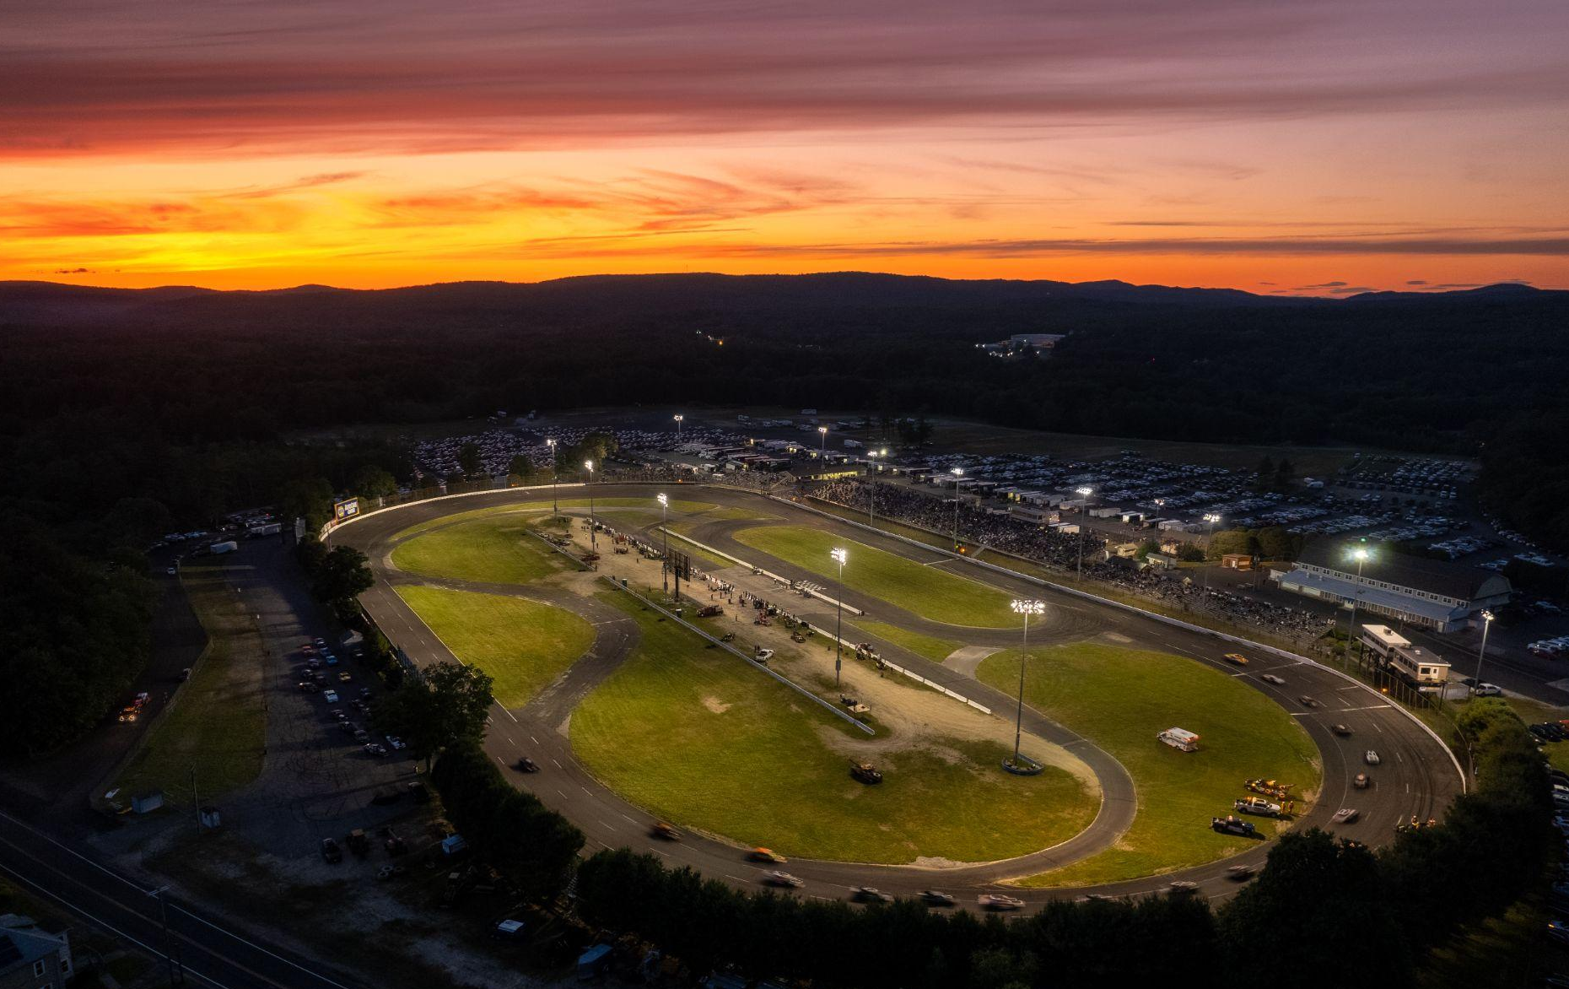
Stafford Motor Speedway
Stafford Speedway: First Class Venue, First Class Competition
Located in Historic Stafford Springs, CT
½ Mile Paved Oval
Founded in 1870
Stafford Springs Agricultural Park
Track First Paved in 1967
Inaugural Spring Sizzler held in 1972
Home of the SK Modified® division
First track to host the SRX Racing series
Friday Night Lights at Stafford Speedway
Stafford Motor Speedway - 55 West Street - Stafford Springs, CT 06076 - 860.684.2783
Staffordspeedway.com // Facebook: @StaffordMotorSpeedway // Instagram: @StaffordSpeedway // Twitter: @StaffordSpeedwy

Slide 4
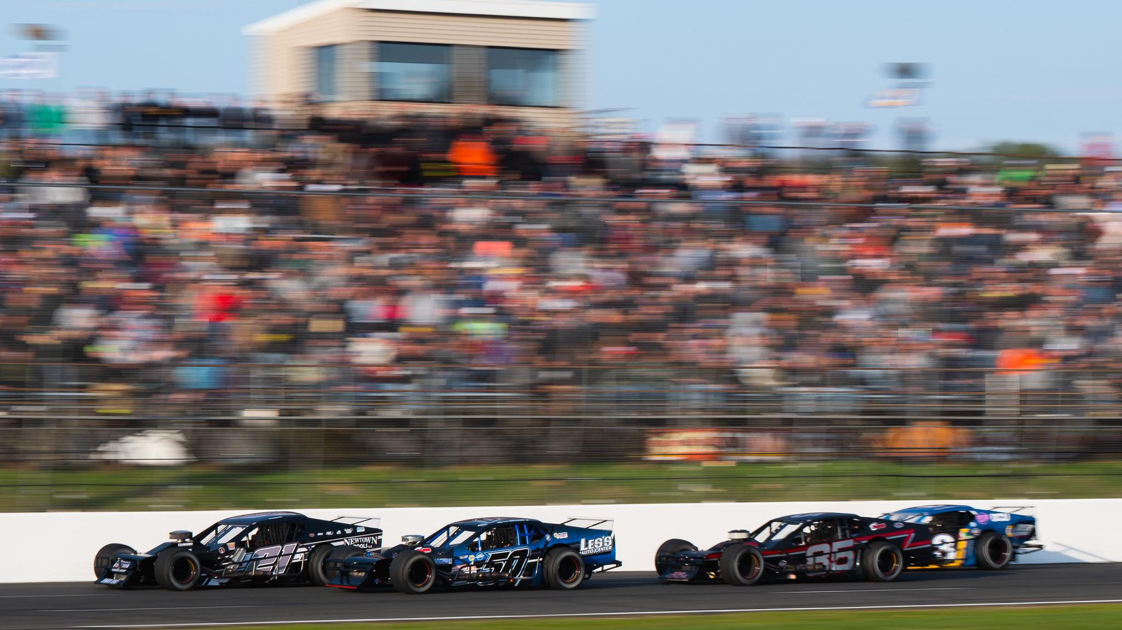
2023 Racing Schedule
Racing Under the Lights Every Friday Night
- 25 Scheduled Racing Events
- 51st running of the Spring Sizzler
- 6 Open Modified events
- Annual attendance ~175,000
- StaffordSpeedway.com/schedule
Stafford’s SK Modified® Division is Recognized as one of the Toughest in the Country
Stafford Motor Speedway - 55 West Street - Stafford Springs, CT 06076 - 860.684.2783
Staffordspeedway.com // Facebook: @StaffordMotorSpeedway // Instagram: @StaffordSpeedway // Twitter: @StaffordSpeedwy

Slide 5
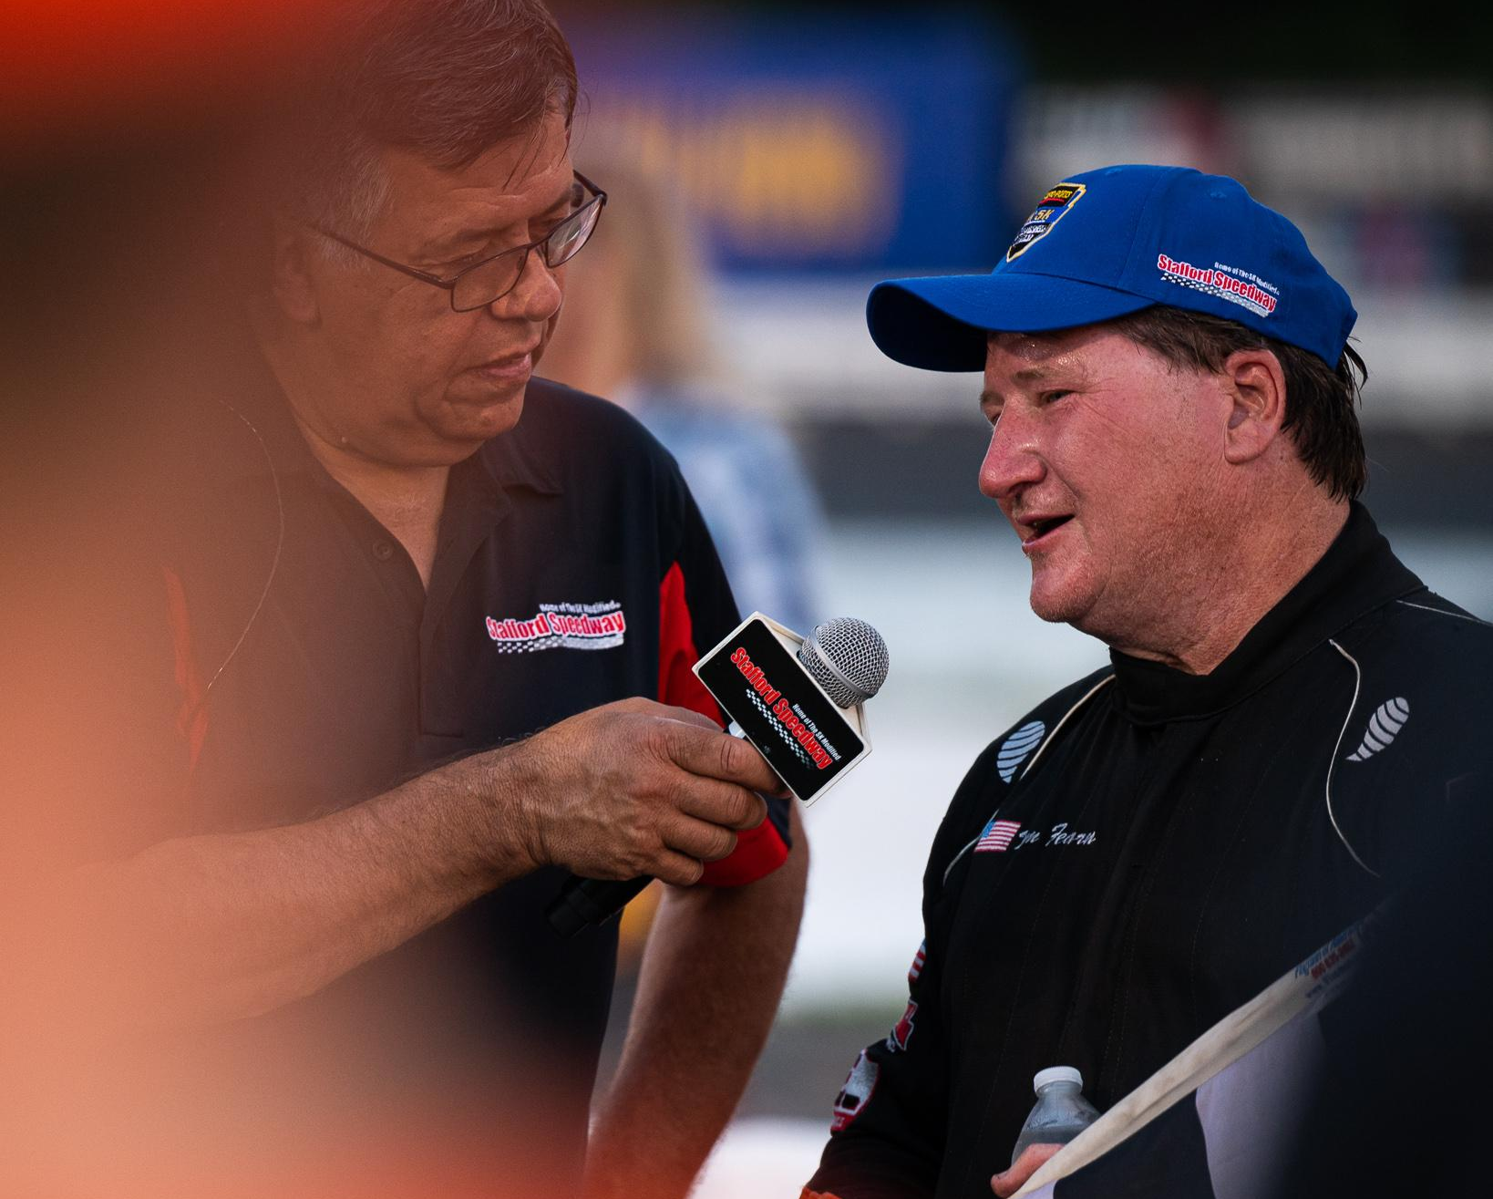
All Events Streamed Live on FloRacing
2022 Stafford Speedway FloRacing Viewership Metrics
Average Weekly Viewers: 15,591
Peak Weekly Viewers: 24,265
- First asphalt track on the FloRacing platform
- Produced in-house by Stafford Speedway
- Recognized as one of the top productions in racing
Live streaming puts Stafford drivers in front of thousands each week
Stafford Motor Speedway - 55 West Street - Stafford Springs, CT 06076 - 860.684.2783
Staffordspeedway.com // Facebook: @StaffordMotorSpeedway // Instagram: @StaffordSpeedway // Twitter: @StaffordSpeedwy

Slide 6
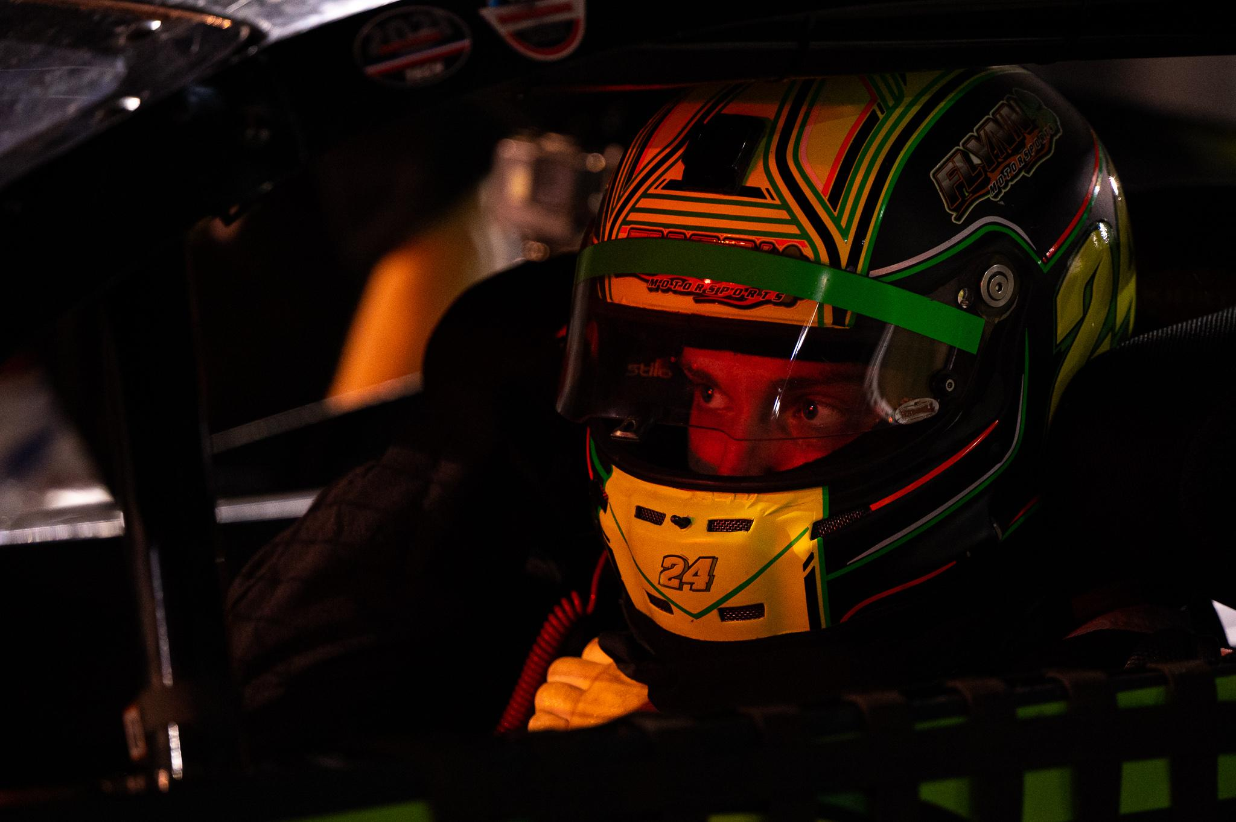
Online Presence
Increasing Fan Engagement through Digital Content
With a large online presence Stafford Speedway showcases your brand to a unique audience
Stafford Speedway Online Presence
Facebook: 33k followers
Instagram: 32.6k followers
Twitter: 11.2k followers
YouTube: 3,850 subscribers
StaffordSpeedway.com:
3 million annual page views
Stafford Motor Speedway - 55 West Street - Stafford Springs, CT 06076 - 860.684.2783
Staffordspeedway.com // Facebook: @StaffordMotorSpeedway // Instagram: @StaffordSpeedway // Twitter: @StaffordSpeedwy

Slide 7
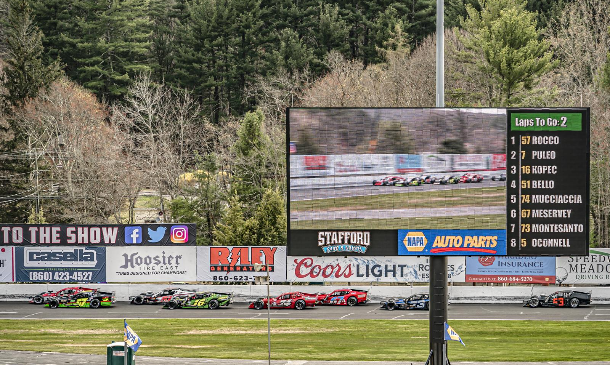
Online Presence
Content First Marketing Approach
Stafford’s content is centered around the drivers & teams, establishing them as the stars of the show
Content featuring your driver online and at the track
Pre and post-race driver interviews
Driver & team profiles
Weekly highlights and driver features
Behind the scenes photos & videos
Victory lane, podium, & starting grid interviews
Stafford’s 20’ x 40’ Video Scoreboard Features Driver Content at Each Event
Stafford Motor Speedway - 55 West Street - Stafford Springs, CT 06076 - 860.684.2783
Staffordspeedway.com // Facebook: @StaffordMotorSpeedway // Instagram: @StaffordSpeedway // Twitter: @StaffordSpeedwy

Slide 8
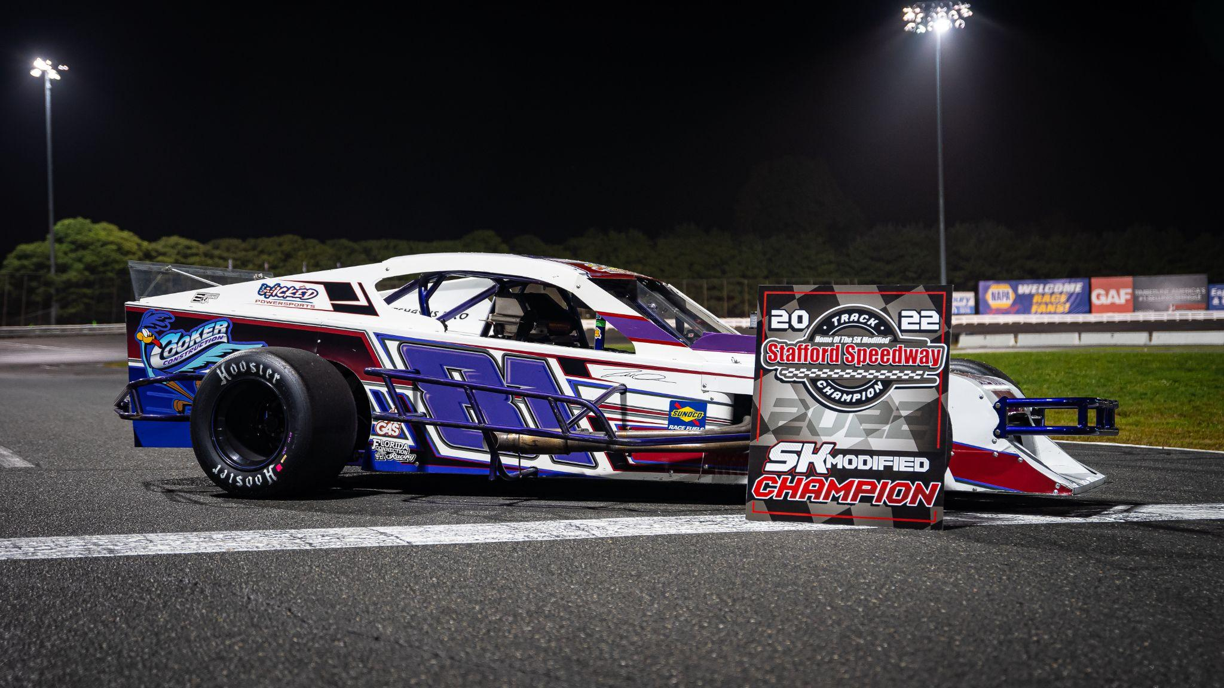
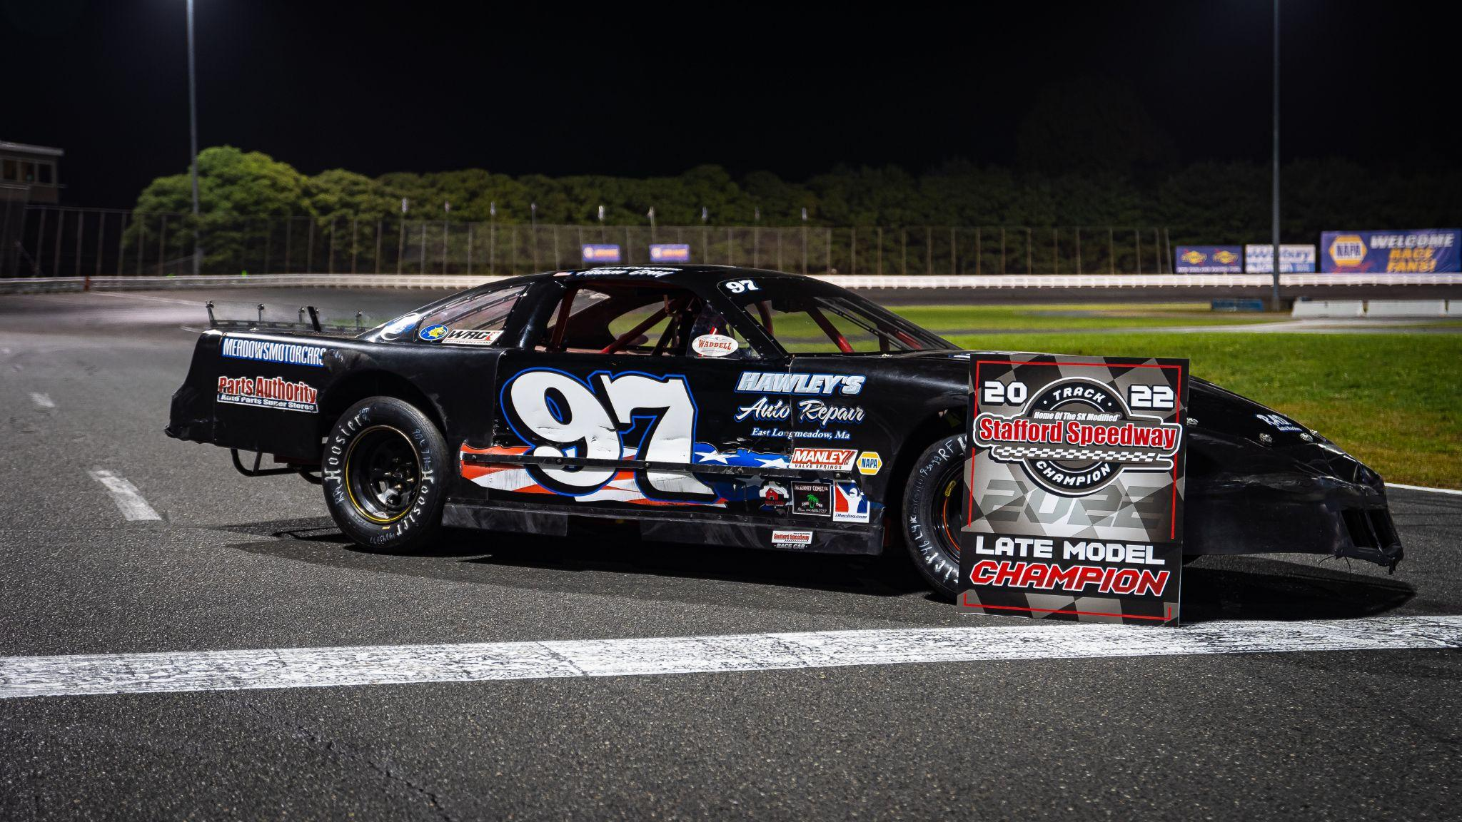
Racing Divisions
SK Modified® - Stafford’s top weekly division often labeled the most competitive weekly division in the country. Open wheel & fast.
Late Model - Stafford’s top full-fender weekly division. This division is rough and tumble producing tough drivers and great racing.
Stafford Motor Speedway - 55 West Street - Stafford Springs, CT 06076 - 860.684.2783
Staffordspeedway.com // Facebook: @StaffordMotorSpeedway // Instagram: @StaffordSpeedway // Twitter: @StaffordSpeedwy

Slide 9
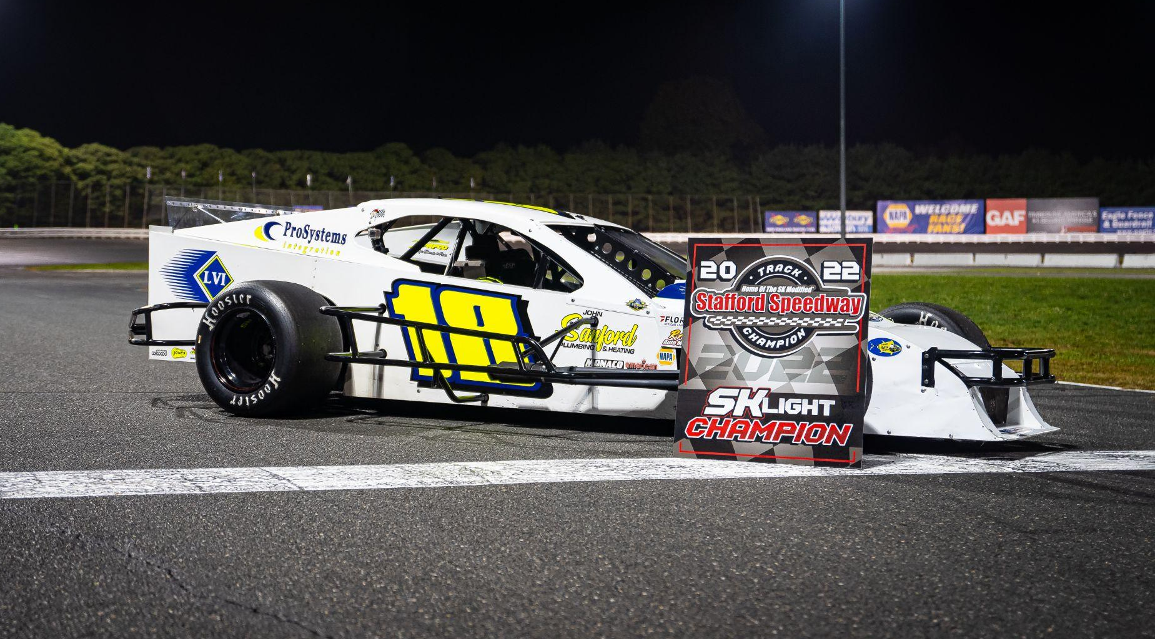
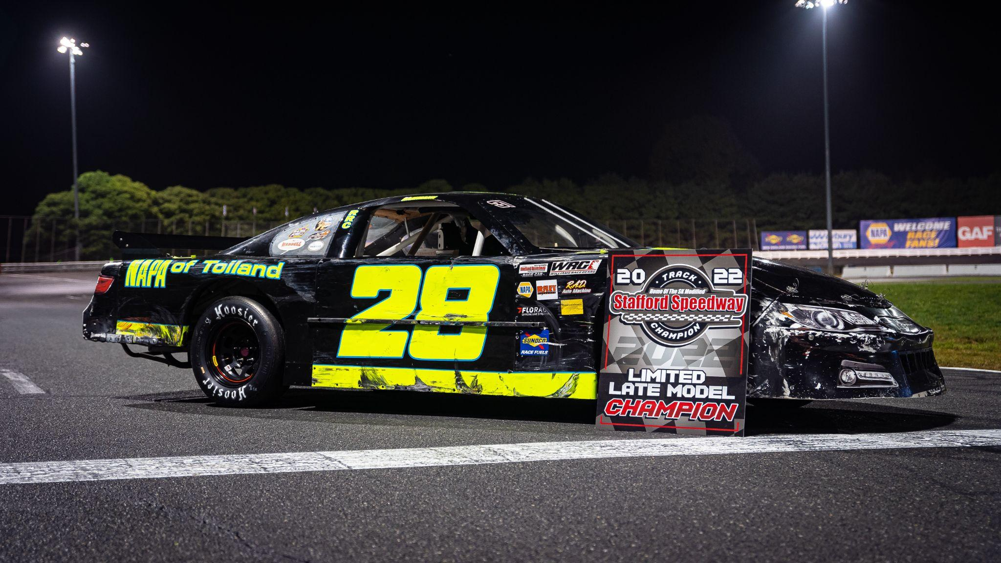
Racing Divisions
SK Light Modified - The younger sibling to the SK Modified, the “Lights” are a more toned down version. Don’t let that fool you, often the best race of the week
Limited Late Model - Just like the “Lights” to the SK Modifieds the “Limiteds” are a toned down version of the Late Model. Nearly half of the Late Model drivers have graduated from this division
Stafford Motor Speedway - 55 West Street - Stafford Springs, CT 06076 - 860.684.2783
Staffordspeedway.com // Facebook: @StaffordMotorSpeedway // Instagram: @StaffordSpeedway // Twitter: @StaffordSpeedwy

Slide 10
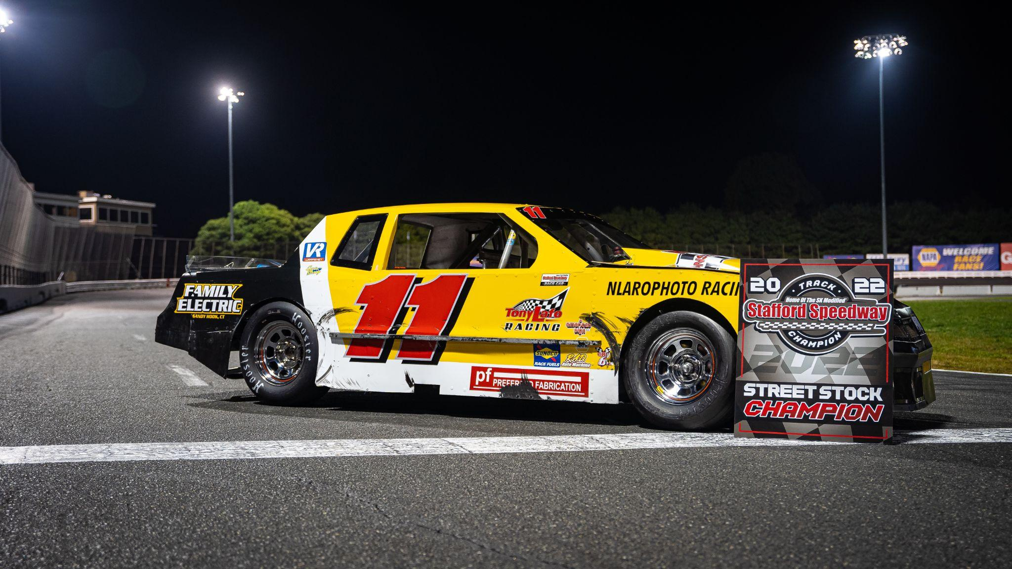
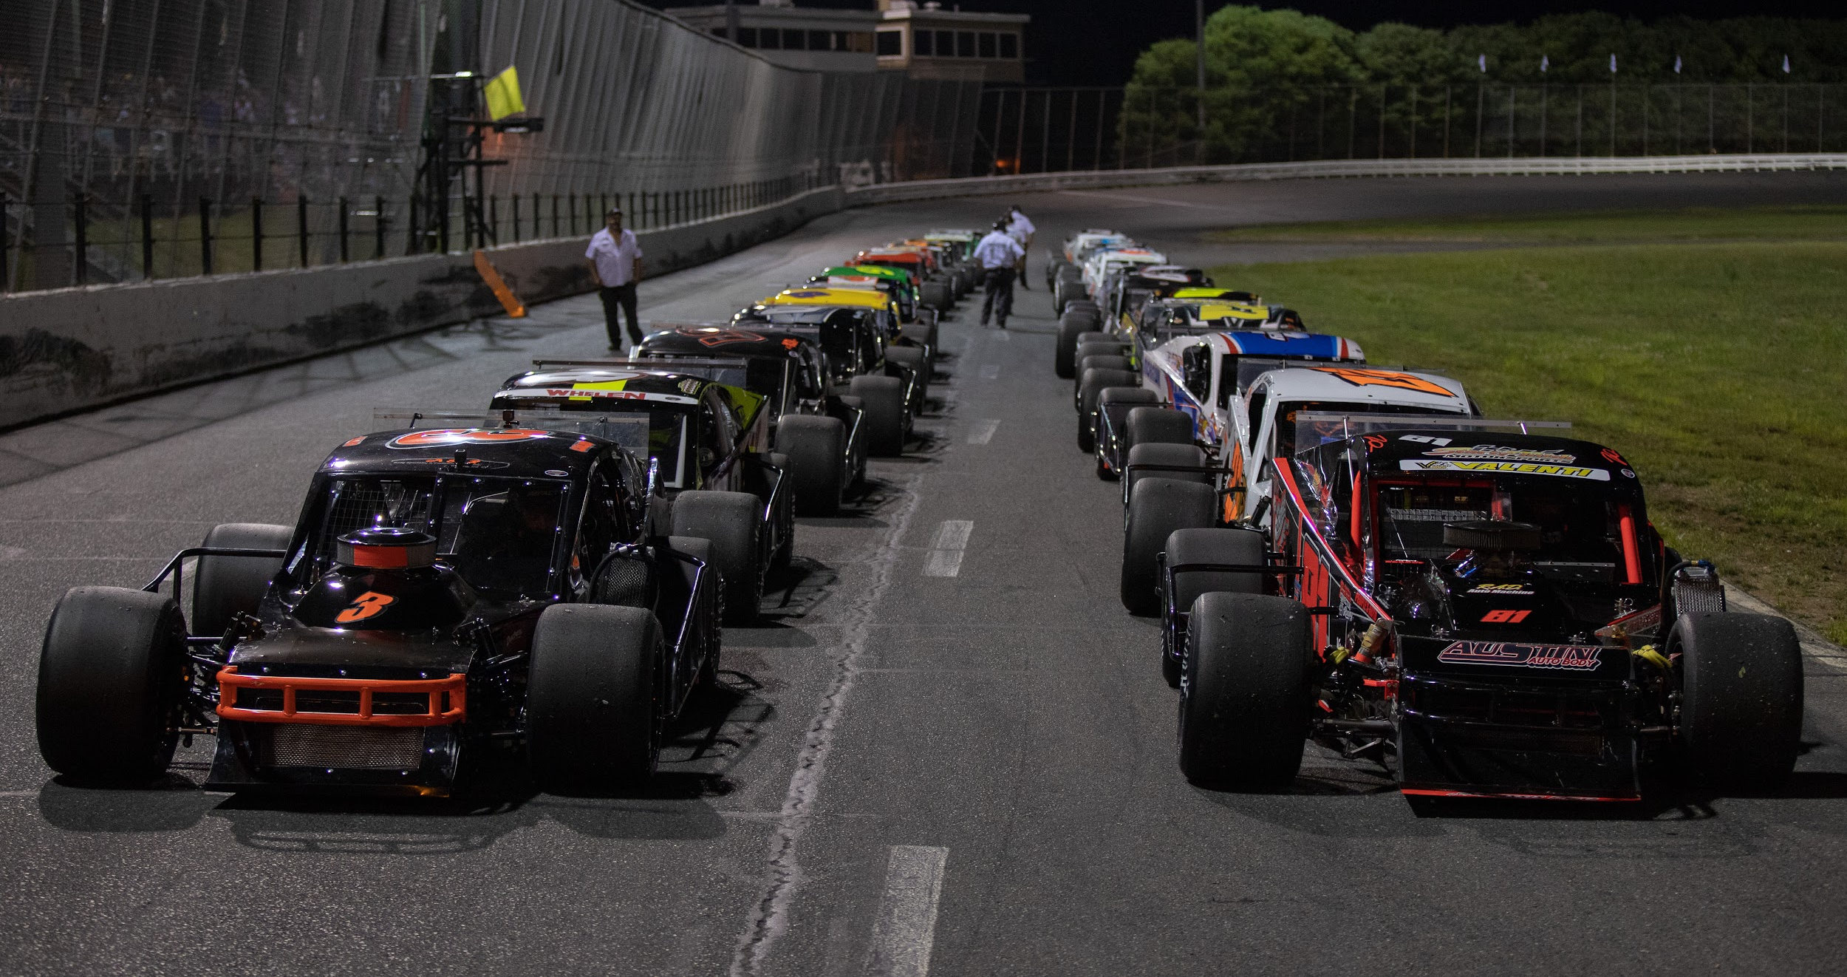
Racing Divisions
Street Stocks - The ultimate grassroots racing division. The Street Stock division is always an exciting mix of young guns and veterans
Open Modified - These cars run at Stafford 4x per year in special 80 lap “Open” events. These 600 HP beasts are regional with drivers hailing from across the Northeast
Stafford Motor Speedway - 55 West Street - Stafford Springs, CT 06076 - 860.684.2783
Staffordspeedway.com // Facebook: @StaffordMotorSpeedway // Instagram: @StaffordSpeedway // Twitter: @StaffordSpeedwy

Slide 11
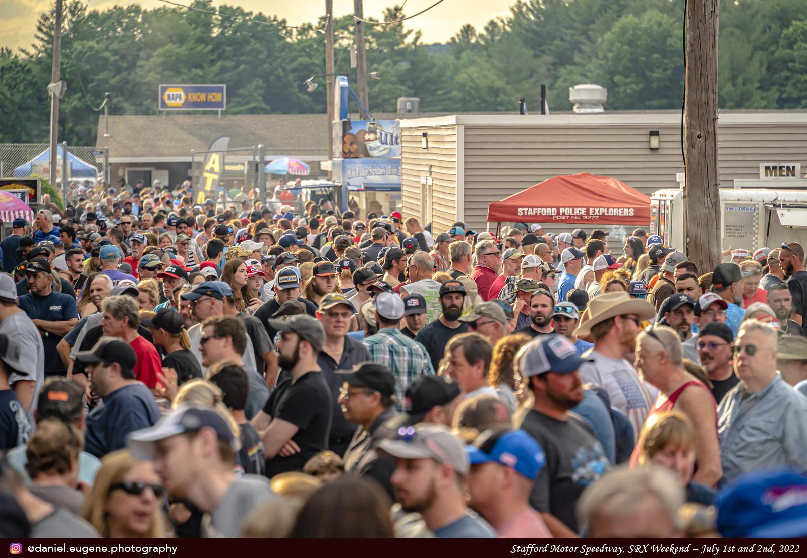
The Race Fan
2021 Stafford Fan Survey Results
How likely are you to choose a brand that supports short track racing over another?
Very Likely - 57.8%
Somewhat Likely - 30.8%
Brand Loyalty
Approx how many Stafford Speedway events do you attend per season?
More than 10 - 41.4%
2 to 5 - 29.23%
6 to 10 - 21.1%
High Engagement
Race Fans: The Most Passionate Fans in Sports
Stafford Motor Speedway - 55 West Street - Stafford Springs, CT 06076 - 860.684.2783
Staffordspeedway.com // Facebook: @StaffordMotorSpeedway // Instagram: @StaffordSpeedway // Twitter: @StaffordSpeedwy

Slide 12
The Race Fan
Where do our fans work? What are their hobbies?
2021 Stafford Fan Survey Results
Top Hobbies - Detailed
Fishing - 26.5%
Cooking - 18.9%
Golf - 18.8%
Camping - 14.2%
Hiking - 13.3%
Top Hobbies Summarized
Outdoor Recreation - 88.8%
Sports - 58.3%
Entertainment - 43.1%
Travel/Vacation - 41.3%
Cars/Trucks/Moto - 28.7%
Top Professions
Construction/Contracting - 23.4%
Retired - 19.1%
Auto Repair/Sales - 10.2%
Finance/Accounting - 9.3%
Retail - 5.5%
What are your top 5 non-racing hobbies?
What is your profession?
Stafford Motor Speedway - 55 West Street - Stafford Springs, CT 06076 - 860.684.2783
Staffordspeedway.com // Facebook: @StaffordMotorSpeedway // Instagram: @StaffordSpeedway // Twitter: @StaffordSpeedwy

Slide 13
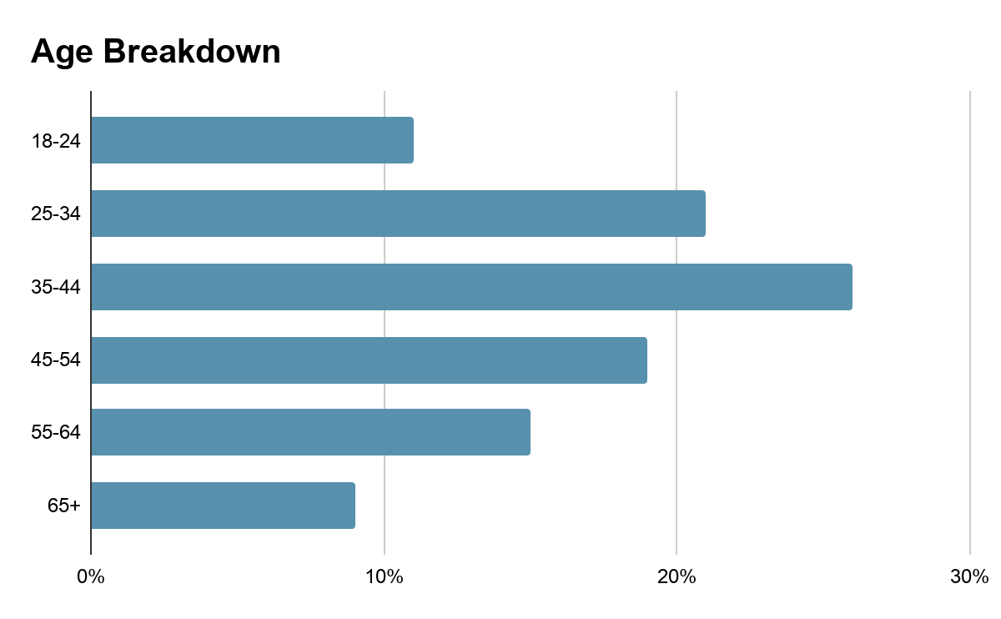
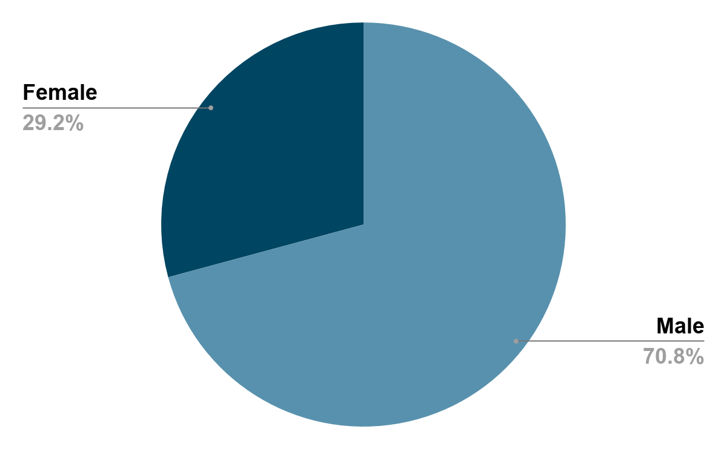
The Race Fan
2021 Stafford Fan Survey Results
Stafford Motor Speedway - 55 West Street - Stafford Springs, CT 06076 - 860.684.2783
Staffordspeedway.com // Facebook: @StaffordMotorSpeedway // Instagram: @StaffordSpeedway // Twitter: @StaffordSpeedwy

Slide 14
The Race Fan
Top Regions
Based on Ticket Sales
Hartford/New Haven, CT
Boston, MA
Springfield/Holyoke, MA
Manchester, NH
Providence, RI/New Bedford, MA
Where do our race fans live?
Top States
Based on Web Traffic
Connecticut
Massachusetts
New York
Rhode Island
Florida
Stafford Motor Speedway - 55 West Street - Stafford Springs, CT 06076 - 860.684.2783
Staffordspeedway.com // Facebook: @StaffordMotorSpeedway // Instagram: @StaffordSpeedway // Twitter: @StaffordSpeedwy

Slide 15
Sponsor Testimonial
“I fully expect to enjoy this return on investment for a long time”
“As a business owner I am very mindful of how I use our marketing resources. We have found our motorsports marketing at Stafford to be very beneficial with a measurable addition to the bottom line while also increasing brand awareness through direct views at the track and online by fans and competitors.
Just in the last year I can quickly recall over a dozen jobs directly from the race track with a total in sales well in excess of my annual sponsorship cost. The racing community is a loyal bunch and through long term sponsorship delivering brand awareness SAFCO Foam has certainly reaped the rewards repeatedly over the years”
Stuart Fearn
SAFCO Foam Insulation
Hampden, MA
Sponsor: #12 Limited Late Model
#12 Late Model & #92 Late Model
Stafford Motor Speedway - 55 West Street - Stafford Springs, CT 06076 - 860.684.2783
Staffordspeedway.com // Facebook: @StaffordMotorSpeedway // Instagram: @StaffordSpeedway // Twitter: @StaffordSpeedwy

Slide 16
Sponsor Testimonial
“We have received a new influx of customer from racing”
"After acquiring an already well-known garbage and waste company in the state, Casella Waste Systems next goal was to let people know they can still get the same great, community orientated service that they were receiving before, just under a different name.
Sponsoring race teams, Stafford Motor Speedway SK Modified contingency program, and a billboard on the back stretch, we have received a new influx of customers saying they have heard of us from racing. But not only that, the community at large has thanked us for our support of the sport.”
Mark DiMauro
Division Manager
Casella Waste Systems
Track & Race Team Sponsor
Stafford Motor Speedway - 55 West Street - Stafford Springs, CT 06076 - 860.684.2783
Staffordspeedway.com // Facebook: @StaffordMotorSpeedway // Instagram: @StaffordSpeedway // Twitter: @StaffordSpeedwy

Slide 17
Sponsor Testimonial
“Advertising at Stafford definitely helps us reach our target audience”
“Call Before You Dig of Connecticut (CBYD) has been a long time sponsor at Stafford Motor Speedway as a track sponsor, sponsor of special events, and sponsor of race teams. The sponsorship has helped increase public awareness for CBYD with billboards, signage, along with digital exposure online. CBYD relies on advertising to help promote public awareness and damage prevention education. Stafford definitely helps us reach our target audience.
The CBYD partnership with Stafford and race teams at Stafford has provided many new creative opportunities for our marketing efforts. CBYD enjoys being part of “The Show” and we look forward to continuing the partnership for many years to come!”
Derek Brown
Call Before You Dig CT
Track & Race Team Sponsor
Stafford Motor Speedway - 55 West Street - Stafford Springs, CT 06076 - 860.684.2783
Staffordspeedway.com // Facebook: @StaffordMotorSpeedway // Instagram: @StaffordSpeedway // Twitter: @StaffordSpeedwy

